Slide 1
“Shot Boundary Detection (SBD)” Mikołaj Leszczuk, Jakub Nawała
Kraków

Slide 2

Video Summarization
Movie time: 137 minutes
Trailer time: 2-3 minutes
Trailer creation is laborious
Could it be created automatically?
What quality would it have?

Slide 3

Example Summarization

Slide 4
From Full Video to Summarization
Full Video
Shot Boundary Detection (SBD)
Shot Selection
Summarization
Notes:
Wprowadzenie do podsumowywania (streszczania)‏
Cel: stworzyć streszczenie długiej treści
Dwa główne procesy: segmentacja treści i wybór segmentów
Streszczane dane: wideo/audio
Segmentacja do ujęć
Rezultat: dane do przeglądania

Slide 5
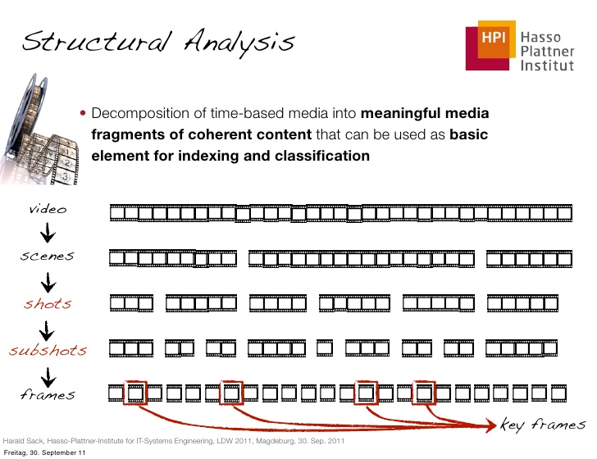
Notes:
Wprowadzenie – klatki (ramki) i ujęcia

Slide 6
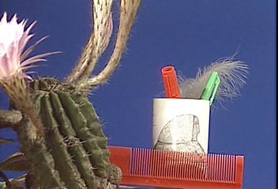

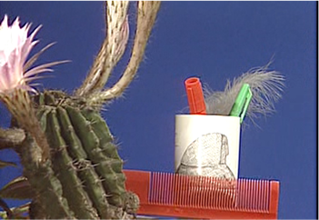
SB Types (1/2)‏
Abrupt cut:
Dissolve:

Slide 7






SB Types (2/2)‏
Fade out:
Fade in:

Slide 8

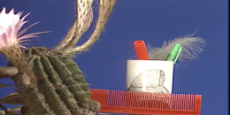
Distinction from SB-Like Events
Camera movements (including pans)‏:
Background movements
Object movements
Zoom:

Slide 9
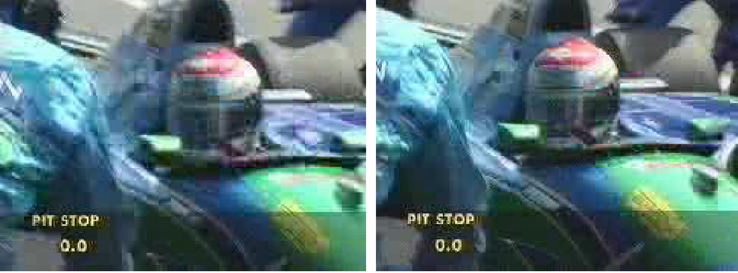
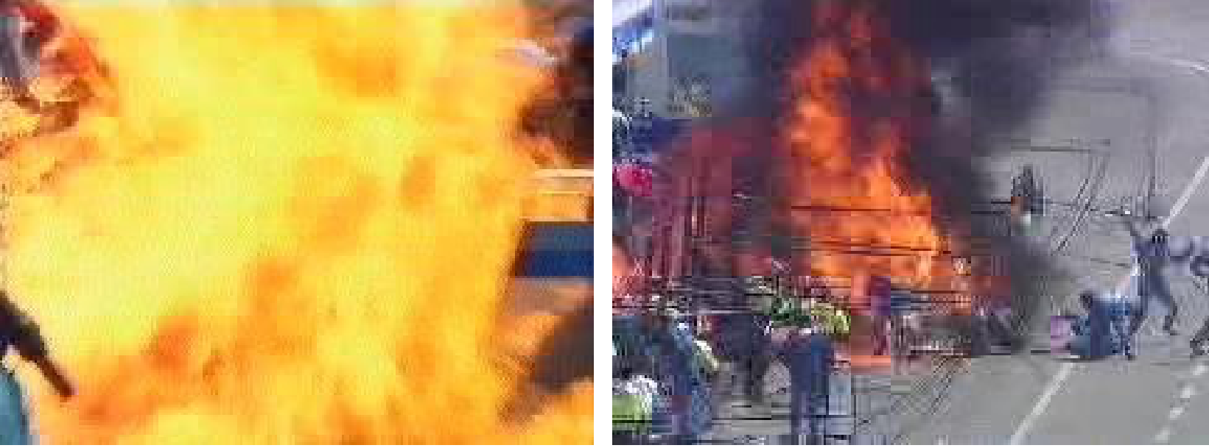
Two Kinds of Possible Errors (Wrong Sensitivity)‏
Detected non-existing SB
Not detected existing SB

Slide 10
Accuracy Evaluations (Input Parameters)‏
 | Number of false SBs (“false alarms”) detected by SBD method False cut are cuts detected by a program, but not existing in analysed video
 | Number of SBs not detected by SBD method
 | Real number of SBs existing in video

Slide 11

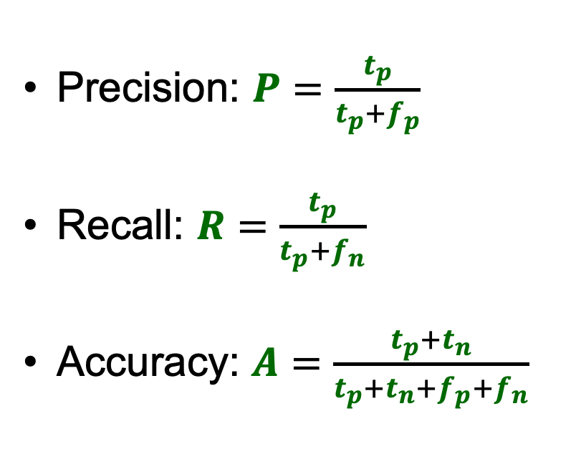
Accuracy Evaluations (Output Parameters)‏
By Walber – Own work, CC BY-SA 4.0, https://commons.wikimedia.org/w/index.php?curid=36926283

Slide 12
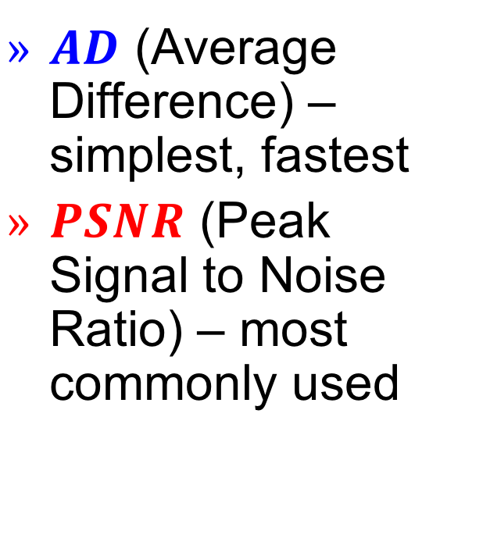
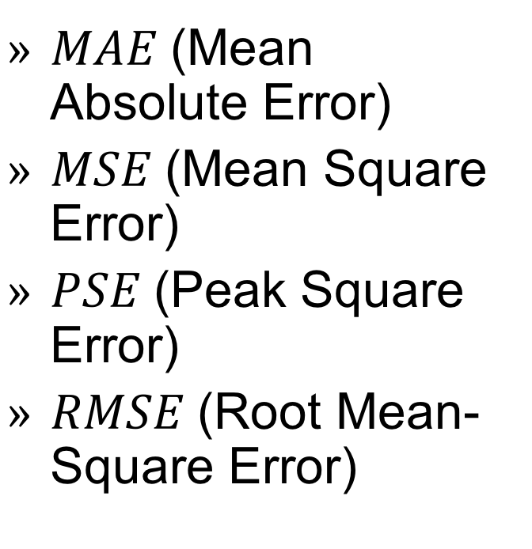
Uncompressed Pixel-Based Comparison SBD Method (1/2)

Slide 13
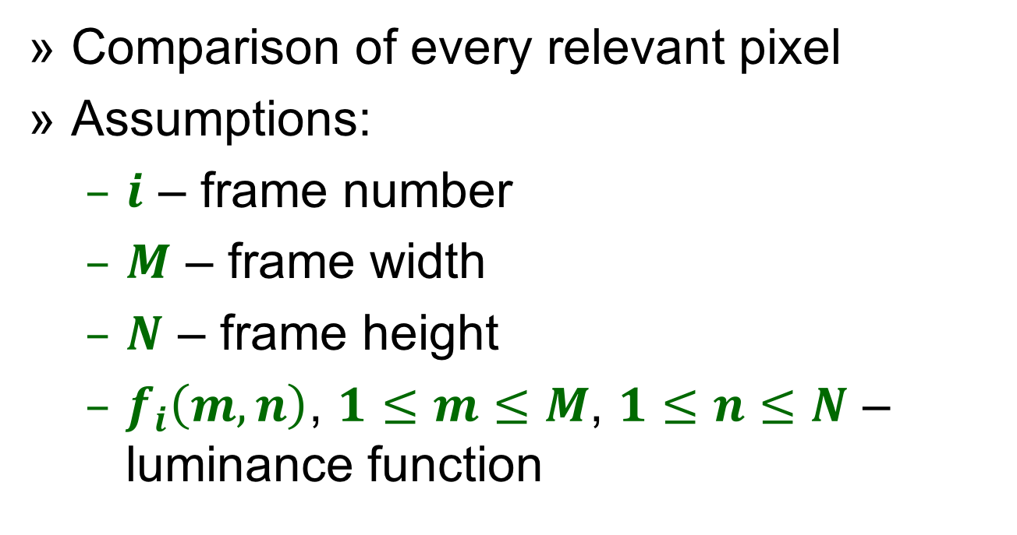
Uncompressed Pixel-Based Comparison SBD Method (2/2)

Slide 14

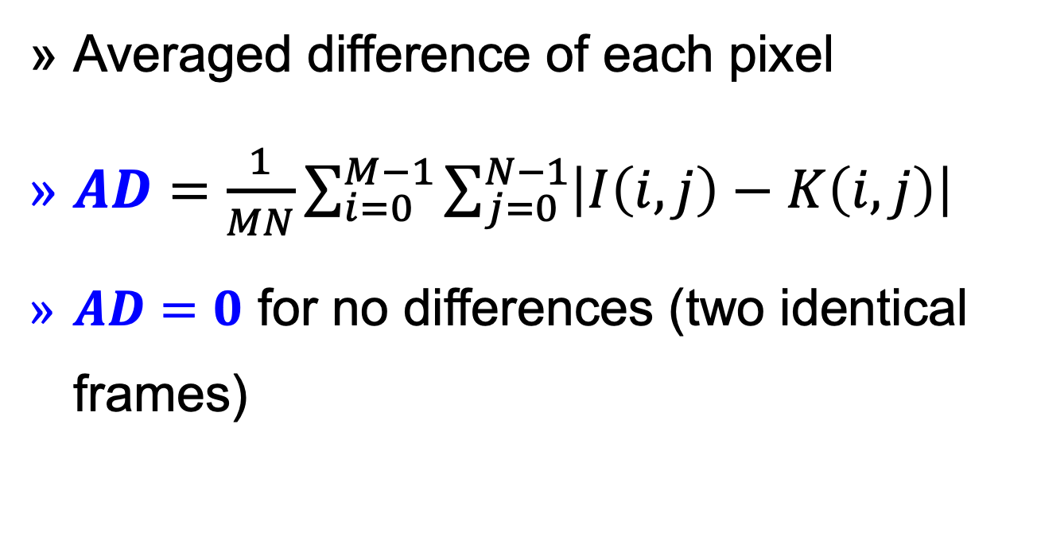

Slide 15

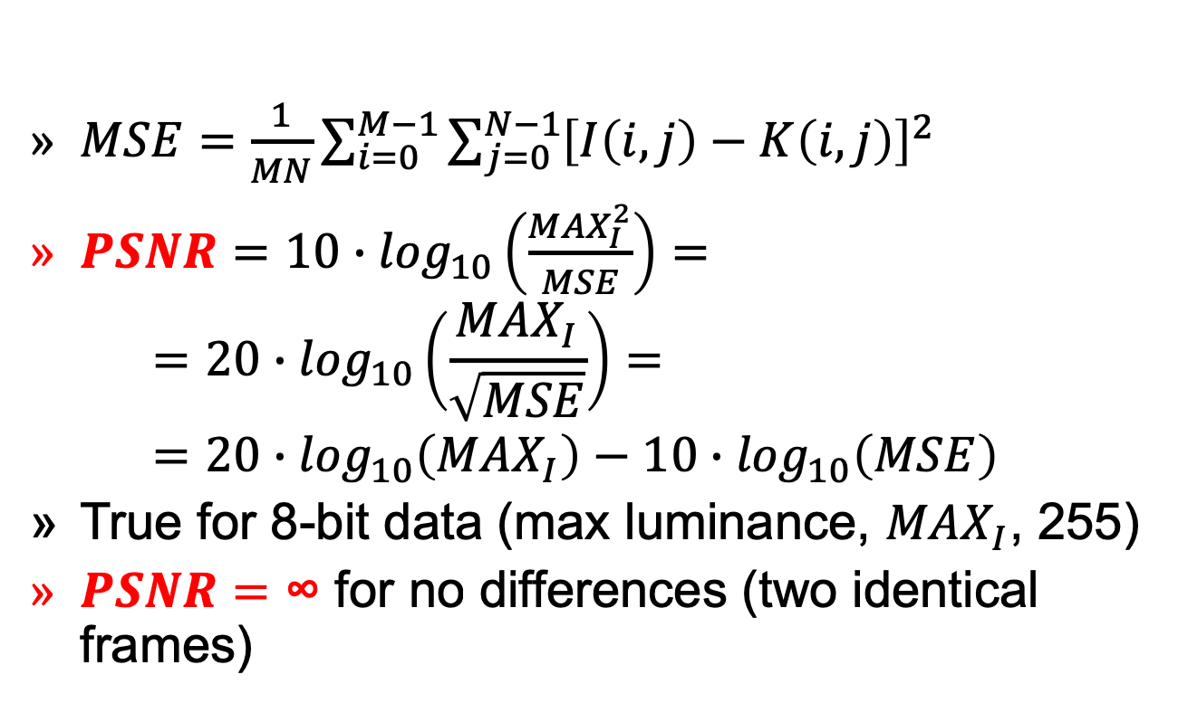

Slide 16

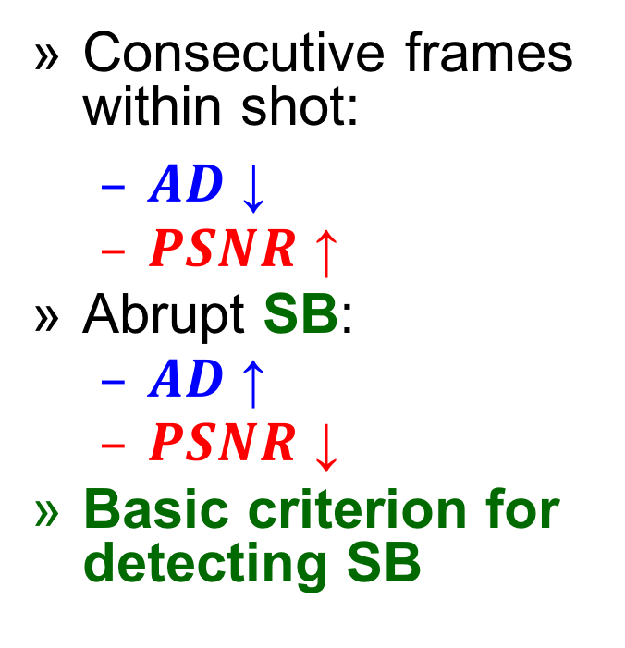
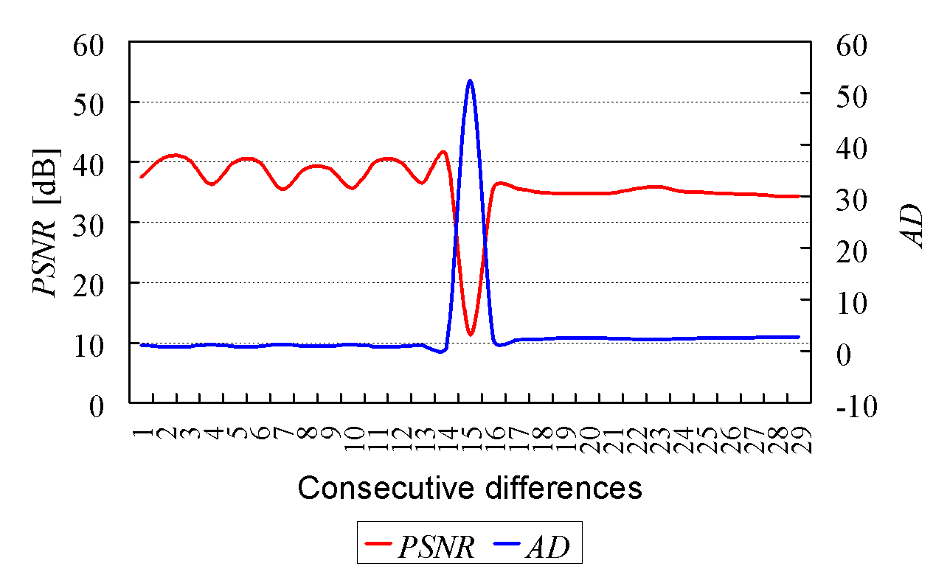

Slide 17

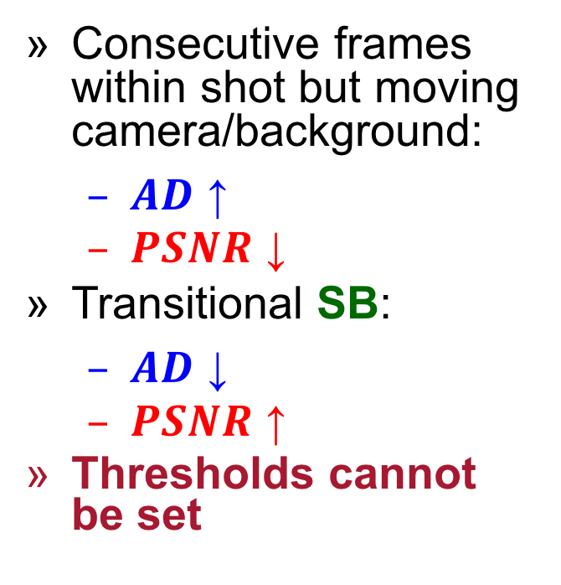
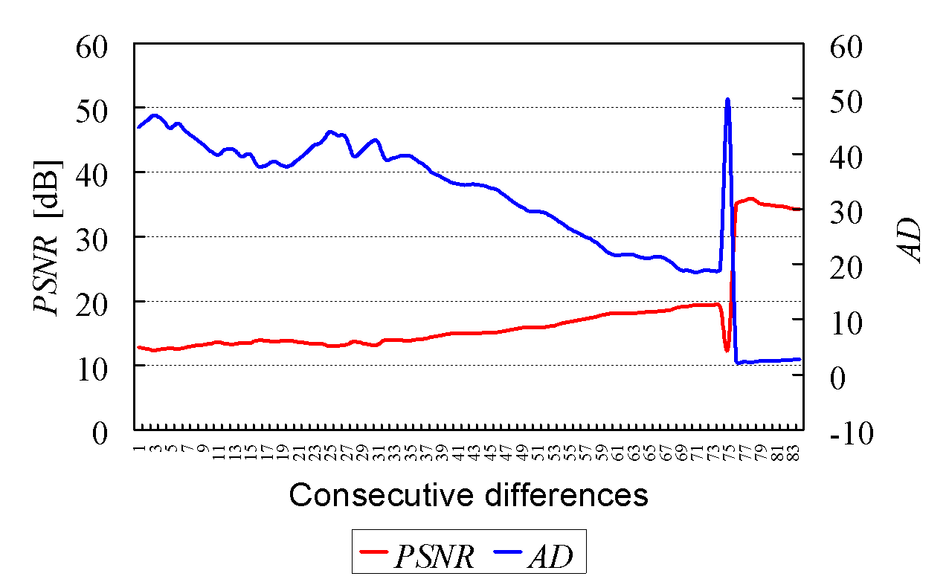

Slide 18

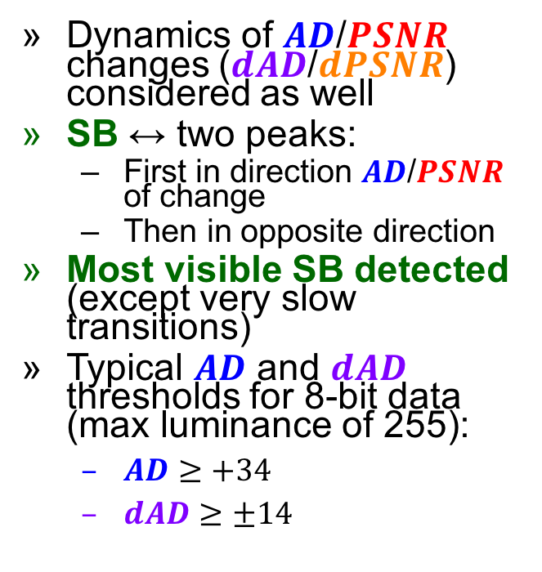
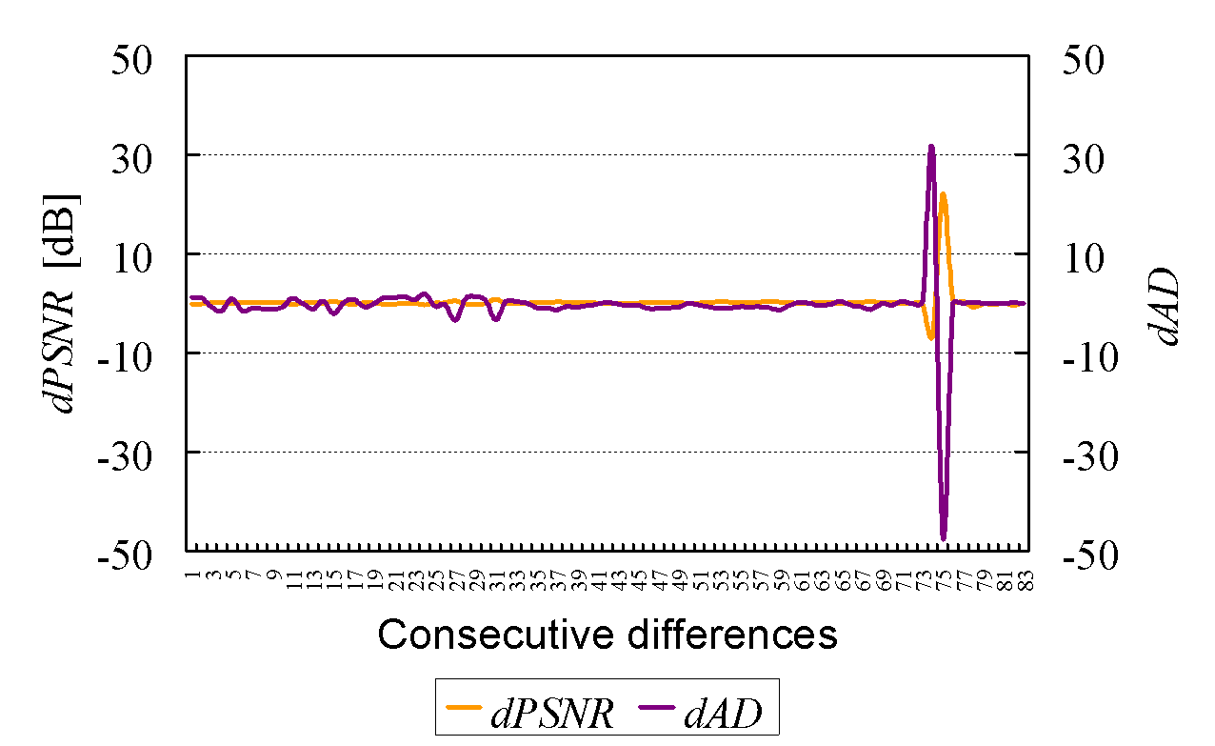

Slide 19
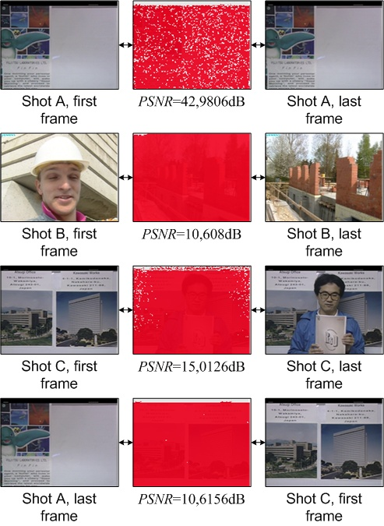
Over-Sensitivity of Pixel Methods
Affecting effects:
Camera motions
Object motions
Rotations
Zooms
Fades
Example ->
Other methods required

Slide 20
Additional Exercise
Your own Shot Boundary Detector (SBD)
Use the Differential MSE (dMSE) method
No dedicated libraries (e.g. PySceneDetect)
Supplementary libraries allowed (e.g. Numpy or Pandas)
Please do it in Python 3
More details in the instruction
Notes:
Differential Mean Squared Error - calculate MSE between each two consecutive video frames and then take the derivative.

